Slide 1
EXPOSYS DATA LABS Data Science Diabetes Disease Prediction
BY BOKKA SWATHI

Slide 2
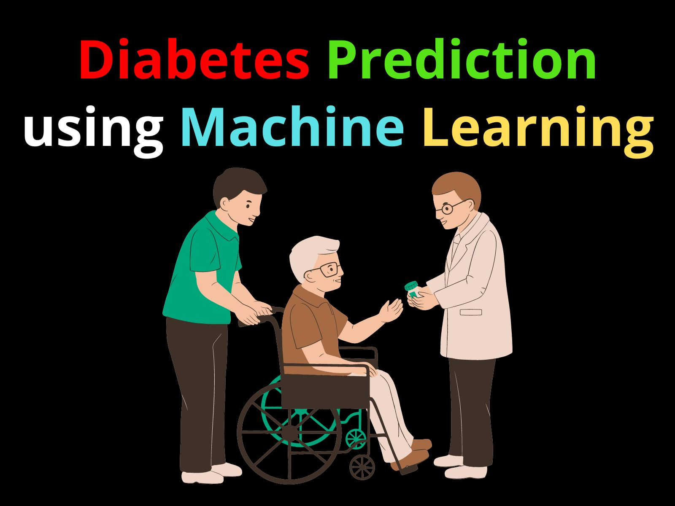
Introduction
Diabetes prediction using data science is a powerful tool for early detection and prevention of the disease.
By analyzing large datasets and applying machine learning algorithms, we can accurately predict the likelihood of developing diabetes.
This presentation will explore the key steps and techniques involved in diabetes prediction using data science.
1

Slide 3
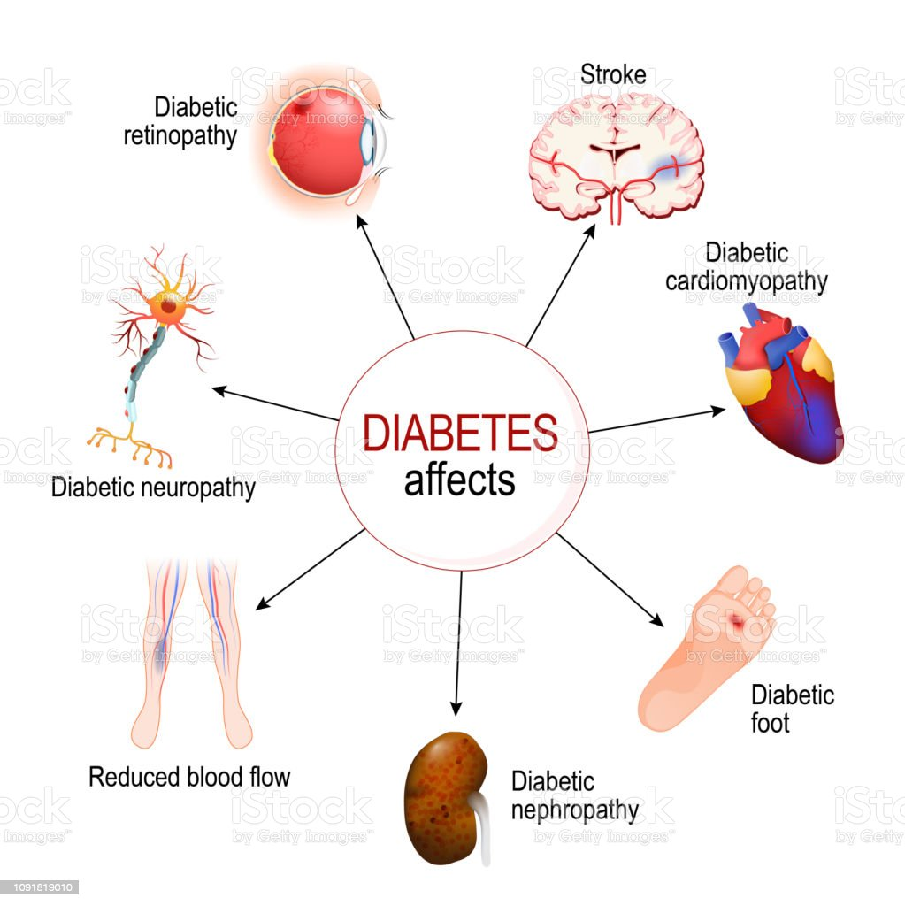
Understanding Diabetes
Diabetes is a chronic disease characterized by high blood sugar levels.
It affects millions of people worldwide and can lead to serious health complications if not managed properly.
By predicting diabetes early, we can intervene with lifestyle changes and medical treatments to prevent or delay its onset.
2

Slide 4
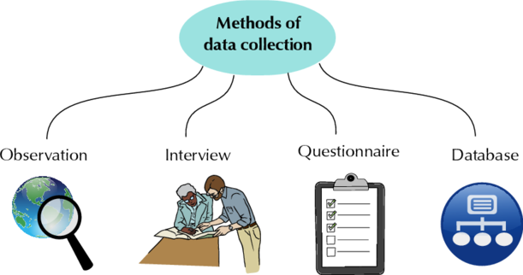
Data Collection
The first step in diabetes prediction is collecting relevant data, including medical records, lifestyle factors, and genetic information.
Data can be obtained through electronic health records, surveys, wearables, and genetic testing.
Quality and quantity of data are crucial for accurate predictions, so data cleaning and preprocessing are vital steps.
3

Slide 5
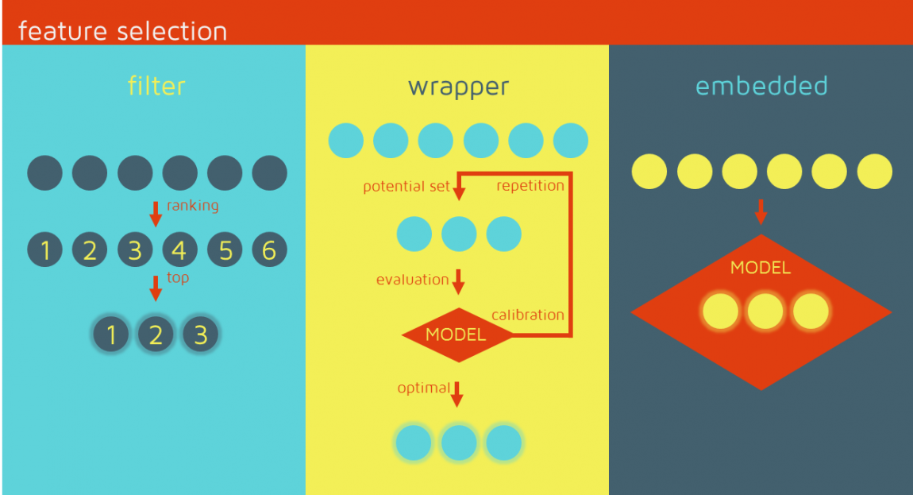
Feature Selection
Feature selection involves identifying the most relevant variables that contribute to diabetes prediction.
Factors such as age, weight, family history, blood pressure, and glucose levels are commonly used.
Advanced techniques like correlation analysis and dimensionality reduction help in selecting the most informative features.
4

Slide 6
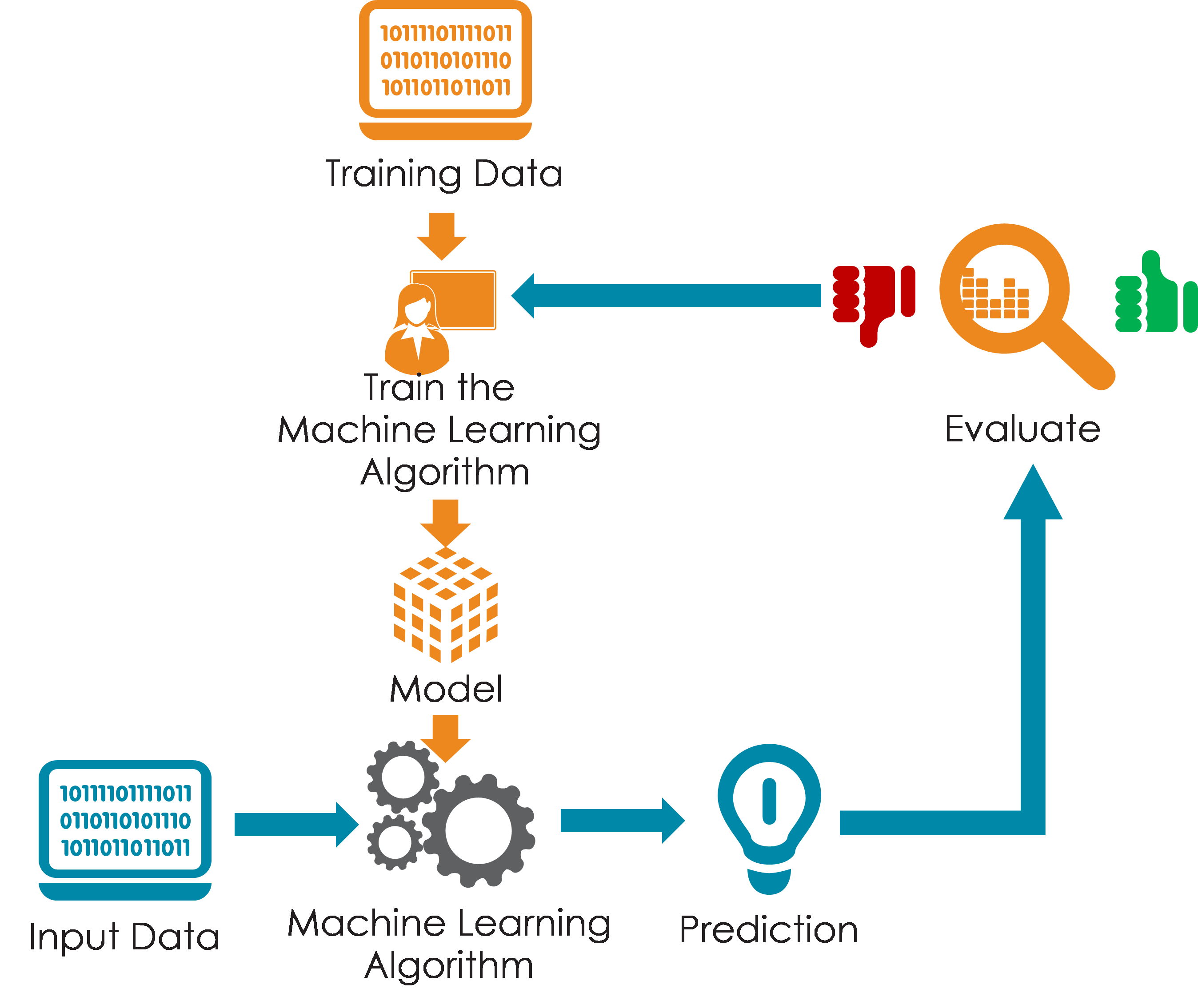
Model Building
Once the features are selected, we can build predictive models using machine learning algorithms.
Common algorithms include logistic regression, decision trees, random forests, and support vector machines.
The models are trained on labeled data and evaluated using performance metrics like accuracy, precision, recall, and F1-score.
5

Slide 7
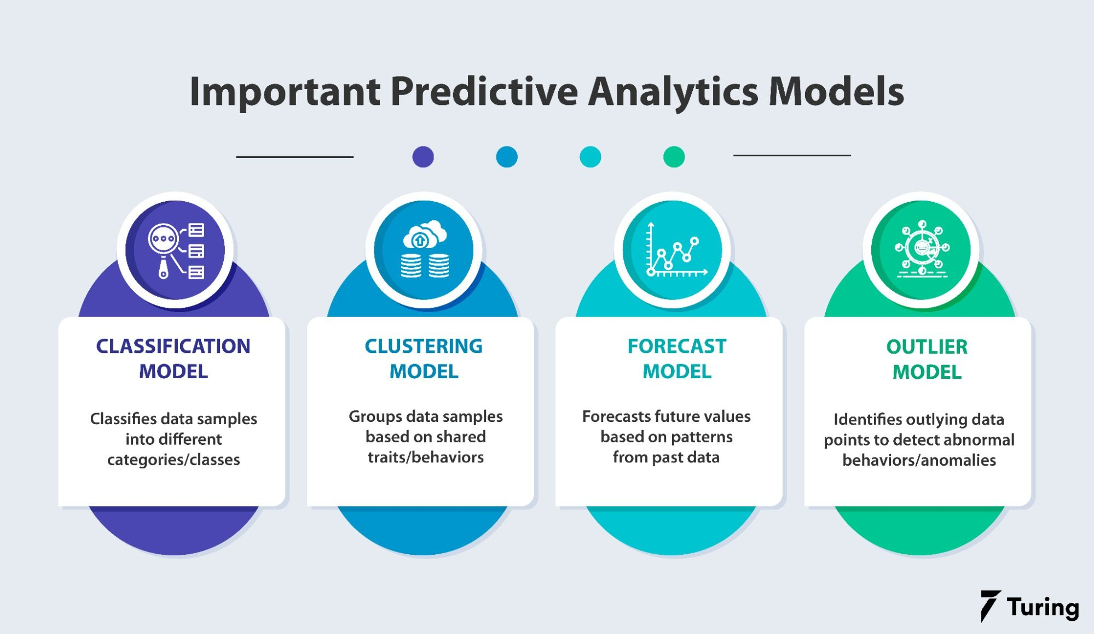
Model Evaluation
Model evaluation is essential to assess the performance and reliability of the predictive models.
Techniques like cross-validation, ROC curves, and confusion matrices help in evaluating the model's predictive power.
Regular monitoring and updating of the model are necessary to ensure its effectiveness over time.
6

Slide 8
Predictive Power
A well-trained diabetes prediction model can accurately identify individuals at risk of developing diabetes.
Early detection allows for timely interventions, including lifestyle modifications, medication, and regular monitoring.
Predictive models can also assist healthcare professionals in making informed decisions and optimizing patient care.
7

Slide 9
Challenges and Limitations
Data availability and quality can be a challenge in diabetes prediction using data science.
Interpretability of complex machine learning models may pose difficulties in understanding the underlying factors.
Ethical considerations, privacy concerns, and potential biases in the data should be addressed.
8

Slide 10

Future Directions
Future research in diabetes prediction will focus on incorporating more diverse data sources and advanced machine learning techniques.
Integration of wearable devices, genetic markers, and real-time data streams can enhance prediction accuracy.
Collaborations between healthcare professionals, data scientists, and policy-makers will drive innovation in diabetes prediction.
9

Slide 11
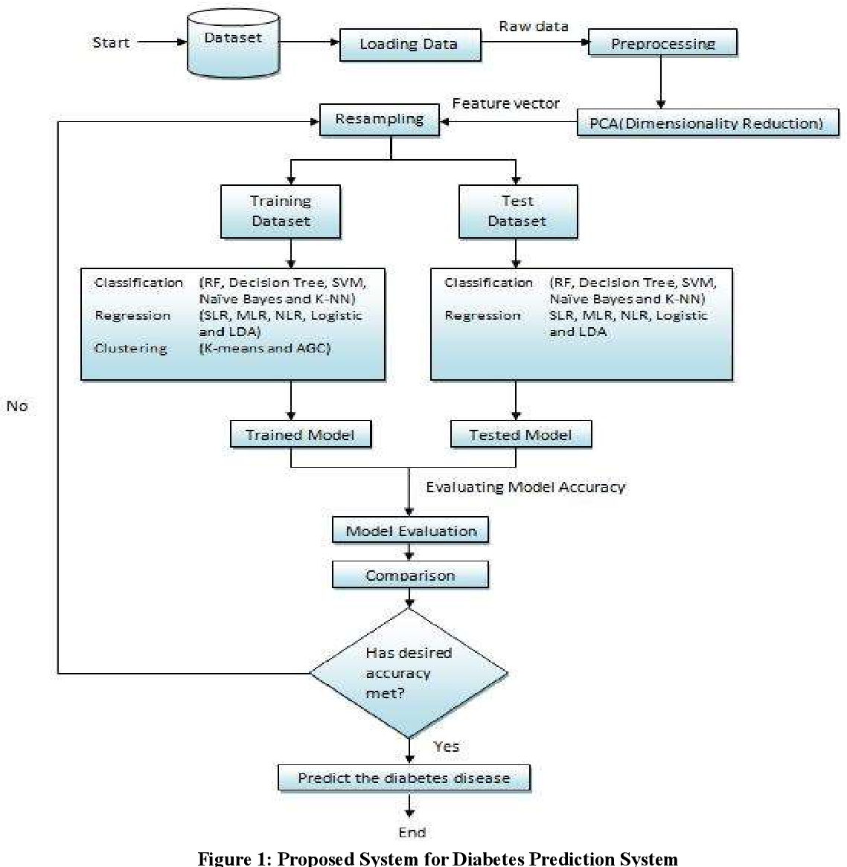
Conclusion
Diabetes prediction using data science is a promising approach for early detection and prevention.
Accurate prediction models can improve patient outcomes and reduce the burden on healthcare systems.
By leveraging the power of data science, we can make significant strides in combating diabetes.
10

Slide 12


